Slide 1


bank loan case study
-By Tanish

Slide 2
TABLE OF CONTENTS
1. PROJECT DESCRIPTION
2. TASK
3. TECH – STACK USED
4. APPROACH
5. INSIGHTS AND RESULT
6. CONCLUSION
7. DRIVE LINK

Slide 3
PROJECT DESCRIPTION
This case study aims to give you an idea of applying EDA in a real business scenario. In this case study, apart from applying the techniques that you have learnt in the EDA module, you will also develop a basic understanding of risk analytics in banking and financial services and understand how data is used to minimize the risk of losing
money while lending to customers.
Business Understanding:
The loan providing companies find it hard to give loans to the people due to their insufficient or non-existent credit history. Because of that, some consumers use it as their advantage by becoming a defaulter. Suppose you work for a consumer finance company which specializes in lending various types of loans to urban customers. You must use EDA to analyse the patterns present in the data. This will ensure that the applicants capable of repaying the loan are not rejected.
When the company receives a loan application, the company must decide for loan approval based on the applicant’s profile. Two types of risks are associated with the bank’s decision:
• If the applicant is likely to repay the loan, then not approving the loan results in a loss of business to the company.
• If the applicant is not likely to repay the loan, i.e., he/she is likely to default, then approving the loan may lead to a financial loss for the company.
Business Objectives:
It aims to identify patterns which indicate if a client has difficulty paying their installments which may be used for taking actions such as denying the loan, reducing the amount of loan, lending (to risky applicants) at a higher interest rate, etc. This will ensure that the consumers capable of repaying the loan are not rejected. Identification of such applicants' using EDA is the aim of this case study. In other words, the company wants to understand the driving factors (or driver variables) behind loan default, i.e., the variables which are strong indicators of default. The company can utilize this knowledge for its portfolio and risk assessment.

Slide 4
TASK
1. Identify Missing Data and Deal with it Appropriately: Identify the missing data in the dataset and decide on an appropriate method to deal with it
2. Identify Outliers in the Dataset: Detect and identify outliers in the dataset.
3. Analyze Data Imbalance: Determine if there is data imbalance in the loan application dataset and calculate the ratio of data imbalance.
4. Perform Univariate, Segmented Univariate, and Bivariate Analysis: Perform univariate analysis to understand the distribution of individual variables, segmented univariate analysis to compare variable distributions for different scenarios, and bivariate analysis to explore relationships between variables and the target variable.
5. Identify Top Correlations for Different Scenarios: Segment the dataset based on different scenarios (e.g., clients with payment difficulties and all other cases) and identify the top correlations for each segmented data.

Slide 5



TECH-STACK USED
IDLE PYTHON: FOR DATA CLEANING, ANALYZING, ETC.
POWER BI DESKTOP: FOR GRAPHS/CHARTS
MICROSOFT POWERPOINT (VERSION: MICROSOFT 360): FOR CREATING THE REPORT

Slide 6
APPROACH
1. Data Acquisition and Familiarization
2. Data Cleaning With Python
3. Data Analysis in Python
4. Visualization in Power BI
5. Project Report

Slide 7
• Data Acquisition and Familiarization: The project began by downloading the datasets from the source. Subsequently, a thorough understanding of the datasets was gained to grasp the structure, variables, and underlying information.
• Data Cleaning with Python: Python programming language was utilized to clean and preprocess the datasets.
Tasks included handling missing data.
• Data Analysis in Python: After completing the data cleaning process, preliminary data analysis was conducted
in Python. Exploratory data analysis (EDA) techniques were applied to extract initial insights and identify any noteworthy patterns or trends.
• Visualization in Power BI: The cleaned datasets were then downloaded. Power BI was used to create interactive and visually appealing graphs and visualizations. Different chart types were utilized to represent data effectively and enable insightful exploration.
• Project Report: A comprehensive project report was made, detailing the entire process from data collection to visualization. Insights drawn from the data analysis in both Python and Power BI were documented in the report.

Slide 8
INSIGHTS AND RESULT

Slide 9
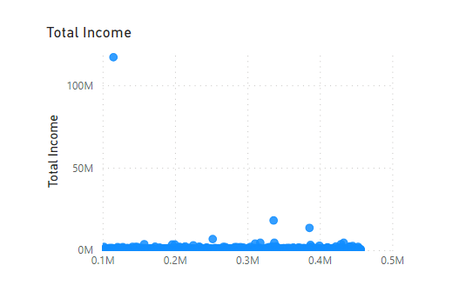
2. Identify Outliers in the Dataset
Income total have outliers indicating a presence of individuals with significantly higher incomes compared to the majority. These outliers may represent high-income
professionals or individuals with substantial investments.
Understanding this distribution can help tailor financial products and assess borrower risk.

Slide 10
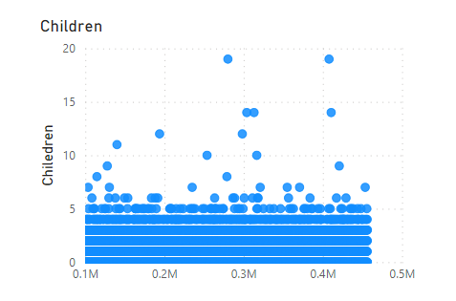
Count of children has outliers
with 19-member families, while
the majority have 2 or 3
children. These outliers may
reflect unique family structures
or cultural dynamics.
Understanding these outliers
helps design loan products that
cater to the specific needs of
larger families.

Slide 11
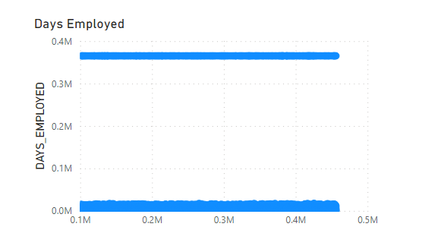
Days employed show outliers,
suggesting some individuals
have been employed for an
unusually long time. This may
indicate stable employment and
a lower risk of job loss.
Recognizing these outliers
informs risk assessment and
enables tailored loan products
for long-tenured employees.

Slide 12
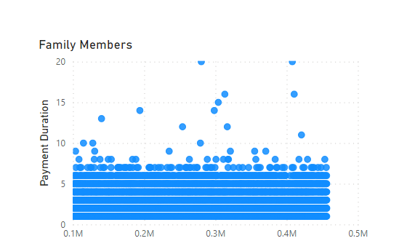
Count of family members exhibits
outliers with 20-member families,
while the majority have 3 or 4
members. These outliers may
represent multigenerational
households or joint families.
Recognizing these outliers allows
for tailored loan offerings that
consider the financial dynamics of larger households.

Slide 13
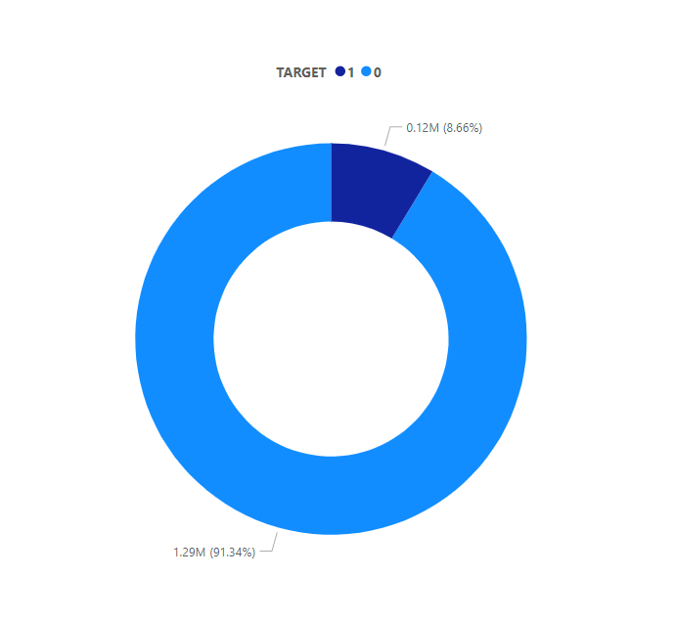
3. Analyze Data Imbalance
The dataset shows a significant
class imbalance, with a ratio of
approximately 1:11 between
non-defaulters and defaulters.
Such a skewed distribution
indicates that the number of
default clients is relatively small compared to non-default
clients.

Slide 14
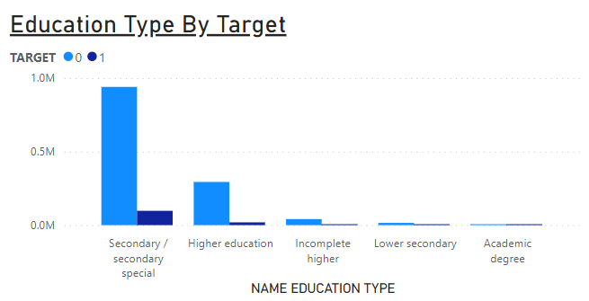
4. Perform Univariate, Segmented
Univariate, and Bivariate Analysis
When considering the clients'
education type, clients with
secondary education are the
ones who take loans most
frequently, followed by clients
with higher education. Clients
with secondary/secondary
special and lower secondary
education are the ones who
face payment difficulties.

Slide 15
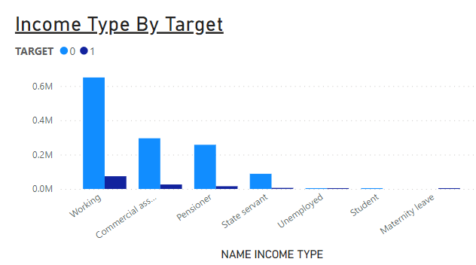
When considering the clients' income type, working and commercial associates are the clients who take most of the loans. Working clients mostly have no payment difficulties, but there are also instances of payment difficulties within this category.

Slide 16
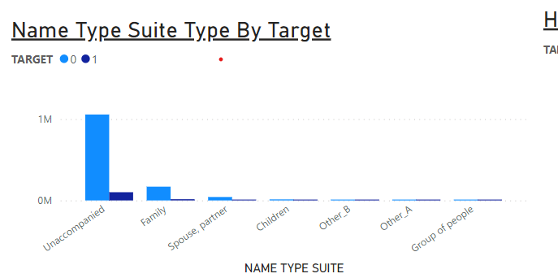
When considering the people who accompanied clients when applying for the loan, most clients come unaccompanied. These clients are also the ones with the highest default rates, as well as the lowest default rates. Some clients are accompanied by family members and most of the time these clients have difficulties in paying back the loan.

Slide 17
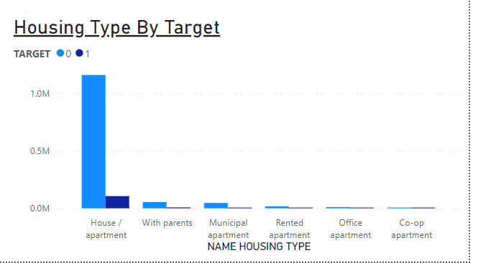
When considering the clients' housing type, most clients live in
houses/apartments, and these clients mostly have no payment
difficulties. Clients living with their parents, however, tend to have more difficulties in making loan payments.

Slide 18
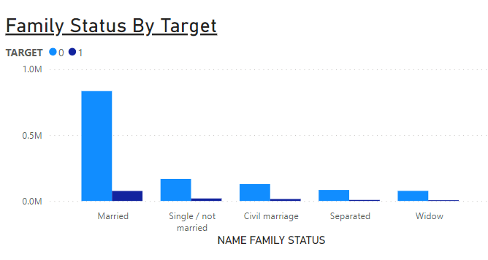
When considering the clients' family status, married clients are the ones who take out more loans. Single/unmarried and civil marriage clients experience higher payment difficulties.

Slide 19
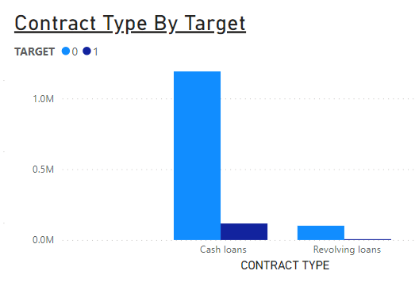
When considering the clients' family status, married clients are the ones who take out more loans. Single/unmarried and civil marriage clients experience higher payment difficulties.

Slide 20
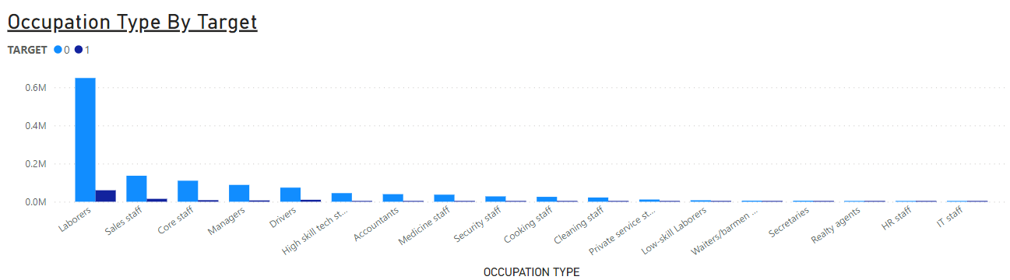
When considering the clients' occupation type, laborers are the ones who take out the most loans. Security staff, drivers, cooking staff, low-skill labor, and waiter/bartender staff are the clients who face payment difficulties.

Slide 21
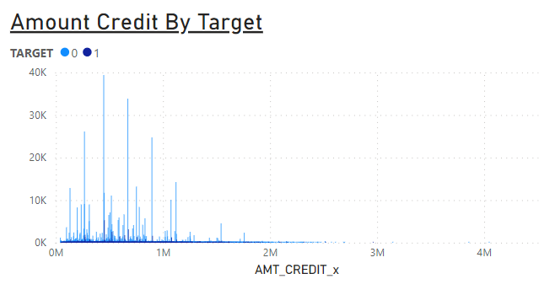
When considering the clients' credit amount, most clients with
payment difficulties have loans ranging from 45,000 to
2,000,000.

Slide 22
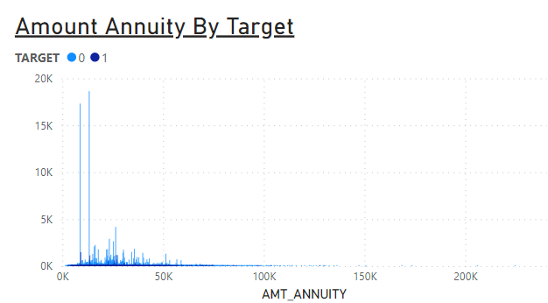
When considering the annuity amount, clients with payment
difficulties mostly have annuity amounts between 2,000 and
100,000.

Slide 23
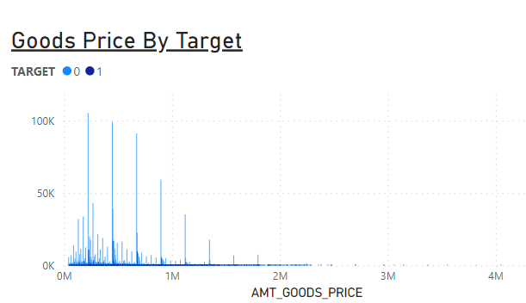
When considering the goods price, clients who have payment
difficulties tend to purchase goods within the range of 45,000
to 2,000,000.

Slide 24
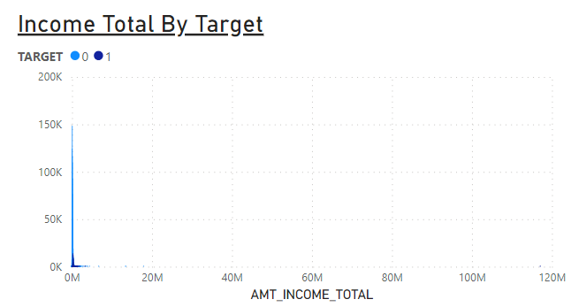
When considering the clients' income, those with an income
range of 25,000 to 3,000,000 are most likely to face payment
difficulties.

Slide 25
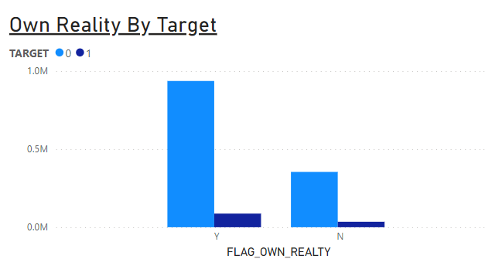
When considering whether the clients own realty, most clients do. Clients who have payment difficulties include both those who own realty and those who don't.

Slide 26
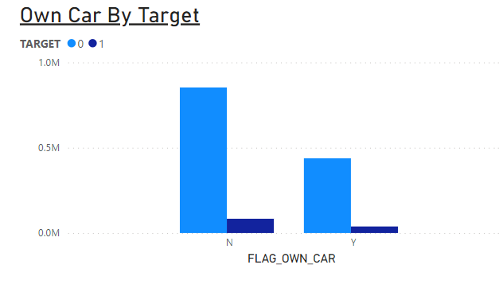
When considering whether the clients own a car, most clients do not own one. However, among the clients who do own a car, there is no significant difference in payment difficulties compared to those who don't.

Slide 27
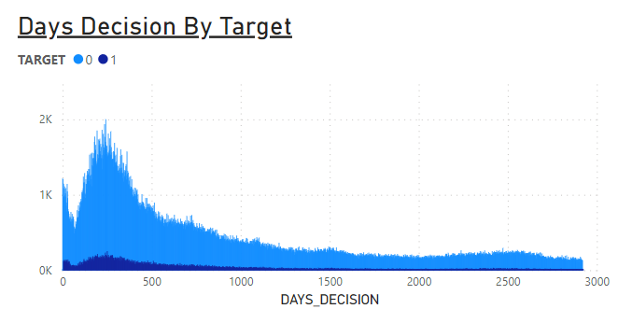
When considering the days taken for decision, whether it is for loan approval or other purposes, the minimum and maximum time observed were 2 days and 2920 days, respectively.

Slide 28
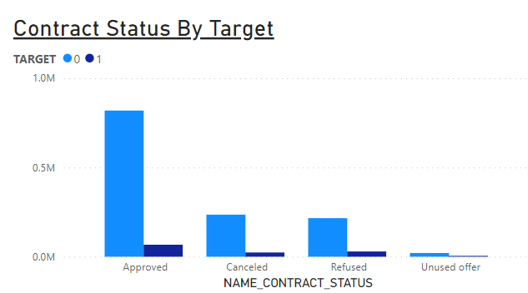
When considering the contract status, most of the loans are approved. However, it is noteworthy that some clients facing payment difficulties initially experience loan refusal for specific reasons. Subsequently, after resolving the identified issues, their loans are reevaluated and ultimately approved.

Slide 29
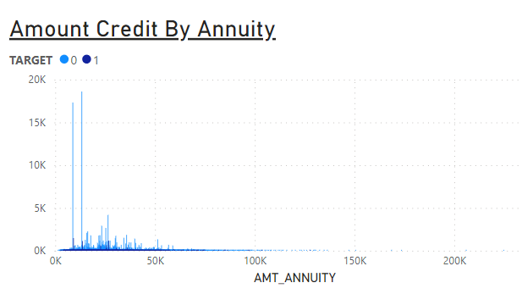
When considering the amount of credit by annuity, the higher the credit amount, the higher the annuity. Clients with payment difficulties usually have a credit amount between 50,000 and 1,000,000.

Slide 30
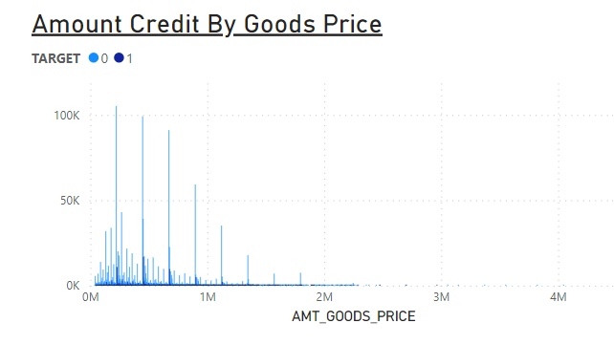
When considering the amount of credit by goods price, clients tend to take higher credit amounts when purchasing more expensive goods. Clients with payment difficulties often buy goods priced between 25,000 and 4,000,000.

Slide 31
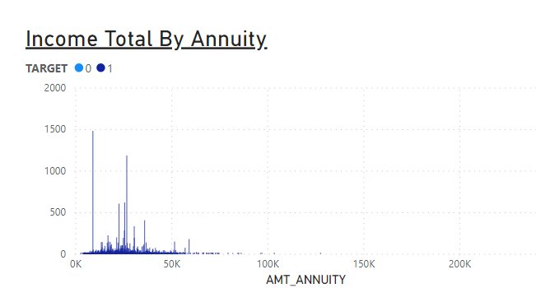
When considering income and annuity, in some cases, clients with higher incomes opt for higher annuities. Clients with payment difficulties usually have an income range between 50,000 and 300,000.

Slide 32
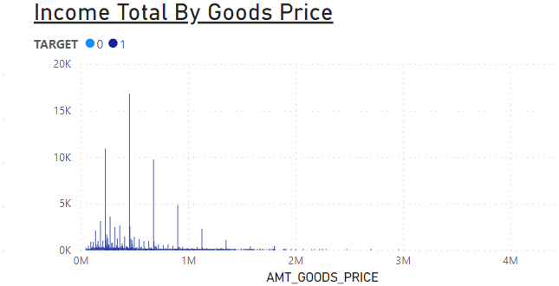
When considering income and goods price, clients with higher incomes tend to purchase goods with higher prices.

Slide 33
5. Identify Top Correlations for Different Scenarios

Slide 34
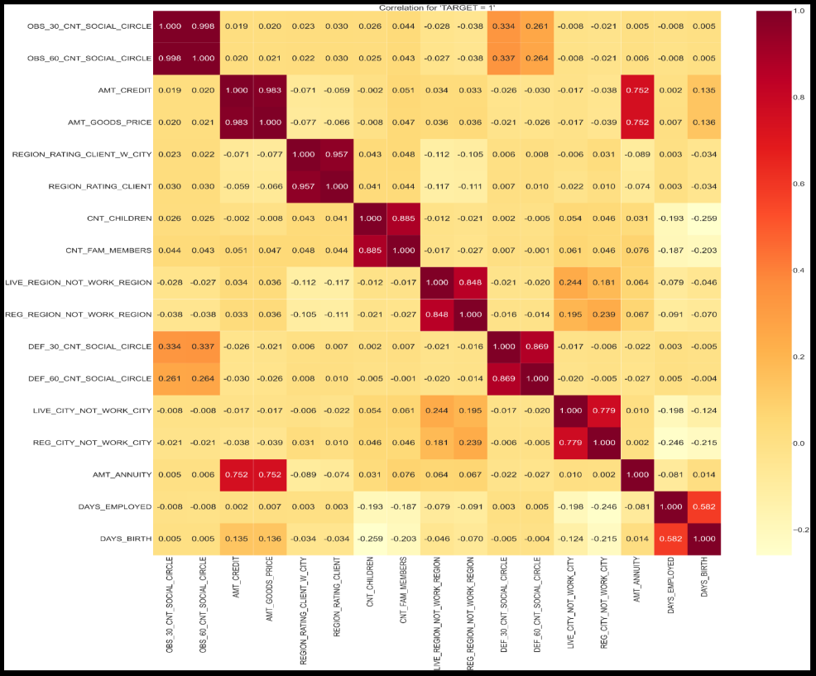
Top 10
Correlation
For TARGET
= 1

Slide 35
Top 10 Correlation For TARGET = 1
1. OBS_30_CNT_SOCIAL_CIRCLE and
OBS_60_CNT_SOCIAL_CIRCLE
2. AMT_GOODS_PRICE and AMT_CREDIT
3. REGION_RATING_CLIENT_W_CITY and
REGION_RATING_CLIENT
4. CNT_CHILDREN and CNT_FAM_MEMBERS
5. DEF_60_CNT_SOCIAL_CIRCLE and
DEF_30_CNT_SOCIAL_CIRCLE
6. LIVE_REGION_NOT_WORK_REGION and
REG_REGION_NOT_WORK_REGION
7. REG_CITY_NOT_WORK_CITY and
LIVE_CITY_NOT_WORK_CITY
8. AMT_ANNUITY and AMT_GOODS_PRICE
9. AMT_CREDIT and AMT_ANNUITY
10.DAYS_BIRTH and DAYS_EMPLOYED
The top 10 correlations with 'TARGET' = 1 reveal significant associations within the dataset. Notably, the variables representing observations of client social circles with observable 30 DPD and 60 DPD demonstrate an almost perfect positive correlation (0.998). Similarly, the strong positive correlation (0.983) between the goods price and credit amount suggests that clients taking larger credits tend to purchase more expensive goods. Additionally,
features related to regional ratings and family size exhibit substantial positive correlations (up to 0.957 and 0.885, respectively). Moreover, clients with a history of defaults show consistent patterns over 30 and 60-day periods (correlation of 0.869). Lastly, certain features hint at connections between living and working regions (correlation of 0.848) and a trend where clients work in the same city where they live (correlation of 0.779). Overall, these correlations offer valuable insights into potential
patterns and dependencies among the variables, aiding in further analysis and model development.

Slide 36
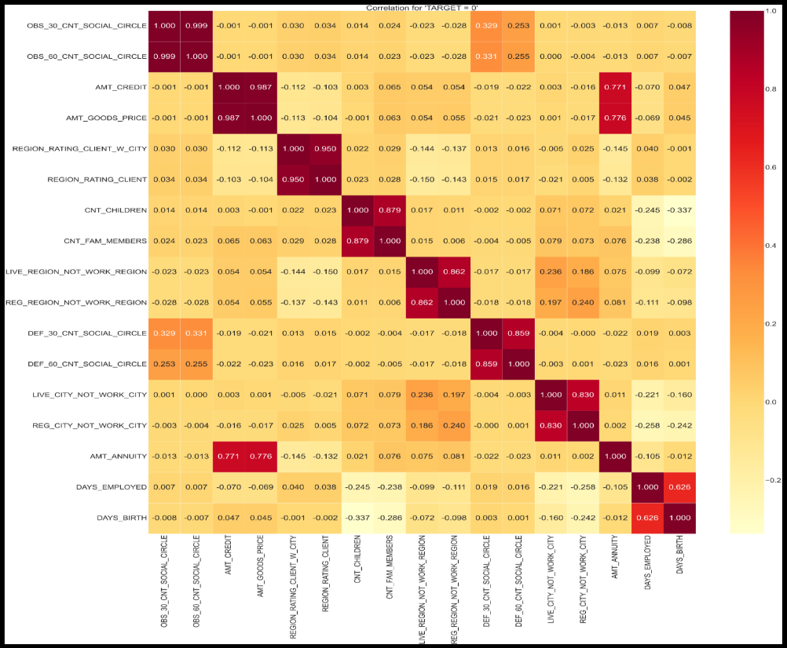
Top 10
Correlation
For TARGET
= 0

Slide 37
Top 10 Correlation For TARGET = 0
1. OBS_30_CNT_SOCIAL_CIRCLE and
OBS_60_CNT_SOCIAL_CIRCLE
2. AMT_CREDIT and AMT_GOODS_PRICE
3. REGION_RATING_CLIENT_W_CITY and
REGION_RATING_CLIENT
4. CNT_CHILDREN and CNT_FAM_MEMBERS
5. LIVE_REGION_NOT_WORK_REGION and
REG_REGION_NOT_WORK_REGION
6. DEF_30_CNT_SOCIAL_CIRCLE and
DEF_60_CNT_SOCIAL_CIRCLE
7. LIVE_CITY_NOT_WORK_CITY and
REG_CITY_NOT_WORK_CITY:
8. AMT_ANNUITY and AMT_GOODS_PRICE:
9. AMT_ANNUITY and AMT_CREDIT
10.DAYS_EMPLOYED and DAYS_BIRTH
The positive correlations indicate that there are
strong relationships between these variable
pairs. For instance, variables representing
observations of client social circles with
observable 30 and 60 DPD demonstrate almost
perfect correlation (0.999). Similarly, the
substantial positive correlation between
AMT_CREDIT and AMT_GOODS_PRICE (0.987)
implies that clients taking larger credits tend to
purchase more expensive goods. Additionally,
features related to regional ratings (0.950) and
family size (0.879) exhibit significant positive
correlations. Moreover, certain features hint at
connections between living and working
regions (0.862) and a trend where clients work
in the same city where they live (0.830). These
insights highlight the interdependencies among
these variables, providing valuable information
for further analysis and modeling.

Slide 38
CONCLUSION
• In conclusion, the insights gathered from this project shed light on various aspects of loan applicants’ characteristics and behaviors. The analysis of income totals revealed the presence of outliers, indicating
individuals with significantly higher incomes compared to the majority. This highlights the importance of considering income disparity when assessing borrower risk and tailoring financial products to cater to
different income levels.
• Overall, these insights contribute to a more nuanced understanding of loan applicants' characteristics, allowing financial institutions to develop tailored loan products, assess borrower risk more effectively, and provide inclusive financial solutions that cater to the diverse needs of their clients. By leveraging these insights, lenders can enhance their decision-making processes, promote responsible lending practices, and support the financial well-being of their customers.

Slide 39
Drive Link
• Link for New Application Data .csv:
https://drive.google.com/file/d/1Wero_zLJ7eiPI0nxoxJRXXzlQ1sCGf2c/view?usp=sharing
• Link for New Previous Application
Data .csv:
https://drive.google.com/file/d/1nonlt7YBpGalo_j9hEcMoAvK6gBbwQ2g/view?usp=sharing
• Merged Final Data.csv:
https://drive.google.com/file/d/13gwqUVTk35lVDro9DiJebMBMYh4WDsGN/view?usp=sharing
Link for Python Code.ipynb:
https://drive.google.com/file/d/12JGW1WSak7HUAUa4EoO3sbx-p6p3TLB7/view?usp=sharing
• Link for Power BI Graphs
https://drive.google.com/file/d/12Stq8bQsF2Bm4vdW6jvtB9bnCUy3ygi8/view?usp=sharing

Slide 40

Thank
You

